Slide 1
What is software, software engineering and software engineer

Slide 2
I’m Zheng Wei

Slide 3
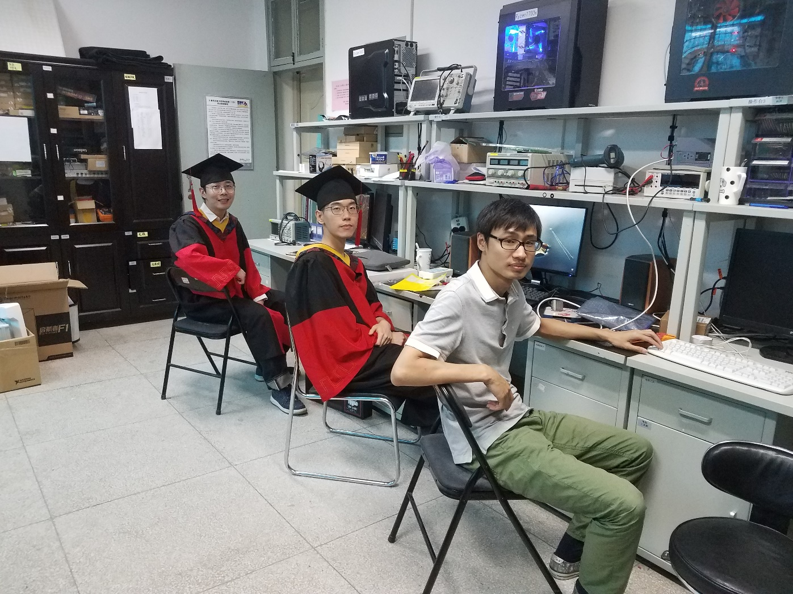
Computer Control Division of IFPP

Slide 4
What is software, software engineering and software engineer

Slide 5
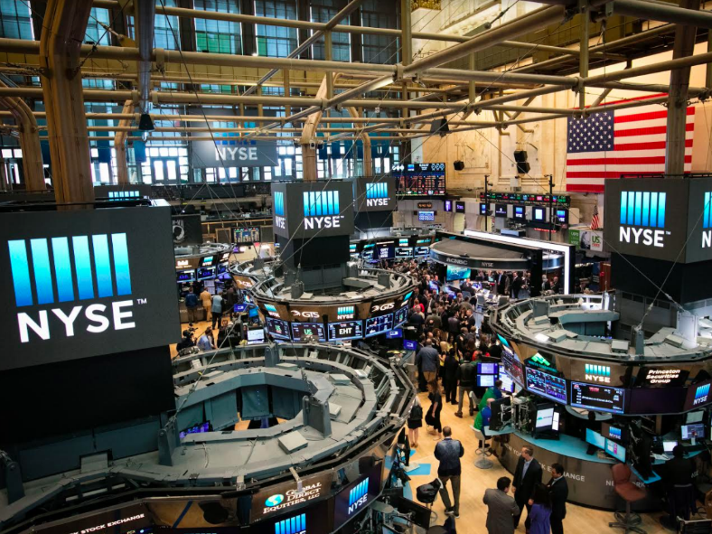
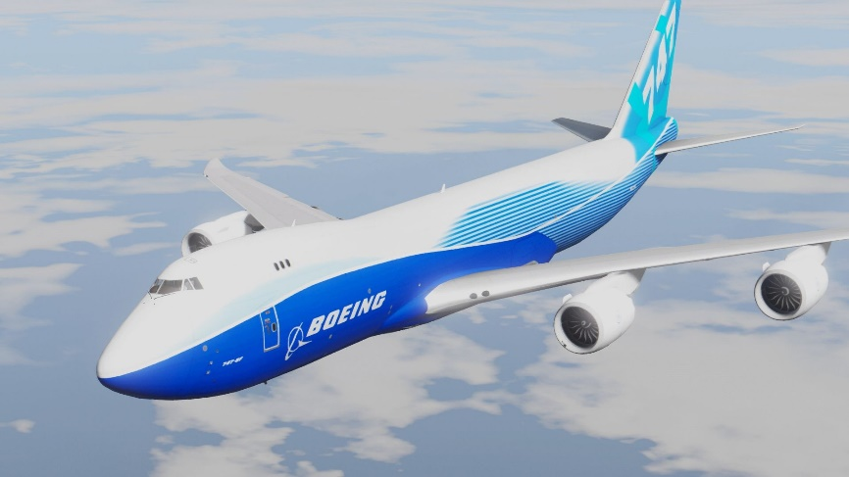



Slide 6
A 747 has 4M lines of code. Most game has 6M…

Slide 7
1L/min*60min/hr*40hrs/wk=2400L 2400L/wk*50wk=120,000L

Slide 8
CODE
And more

Slide 9
How can I help the customer? What is required to solve the customer’s problem? How will the customers interact with the system? What is the overall system structure and how different components interact with each other? How do I organize the team? Can we finish the game in time to have in on the shelves for the holiday?

Slide 10
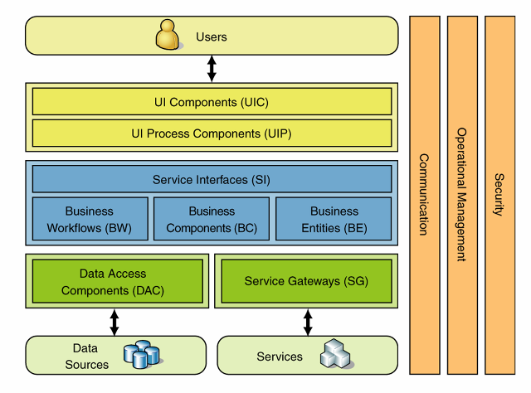
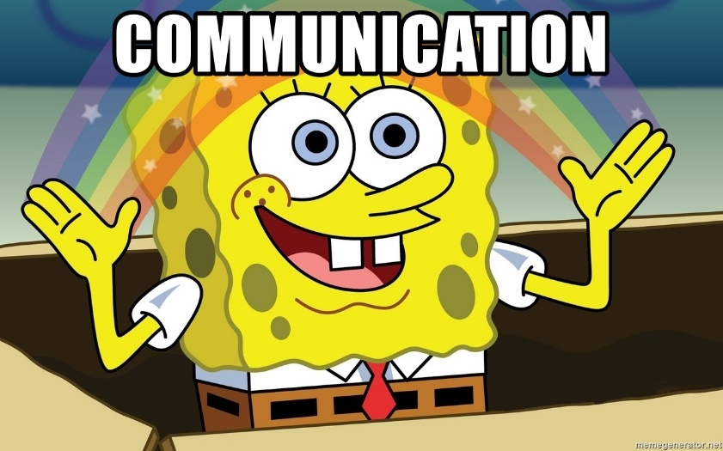
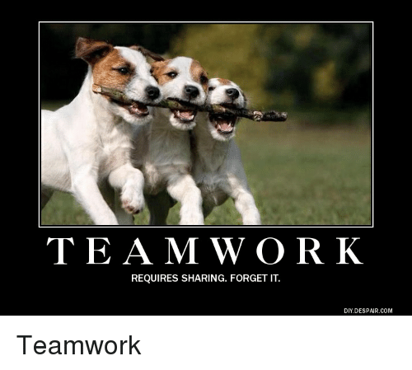

Slide 11
Computer Science Scientists build things to learn something new Software engineering Engineers build thing to solve problems

Slide 12
• "the systematic application of scientific and technological knowledge, methods, and experience to the design, implementation, testing, and documentation of software"—The Bureau of Labor Statistics—IEEE Systems and software engineering - Vocabulary[4]

Slide 13
• "The application of a systematic, disciplined, quantifiable approach to the development, operation, and maintenance of software"—IEEE Standard Glossary of Software Engineering Terminology[5]

Slide 14
• "the establishment and use of sound engineering principles in order to economically obtain software that is reliable and works efficiently on real machines"—Fritz Bauer[7]

Slide 15
Our brains are small.

Slide 16
There is not silver bullet in software engineering.
I am not here to tell you what to do.

Slide 17
Write quality code, solve problems, make the world a better place.
--Zheng Wei

